Slide 1
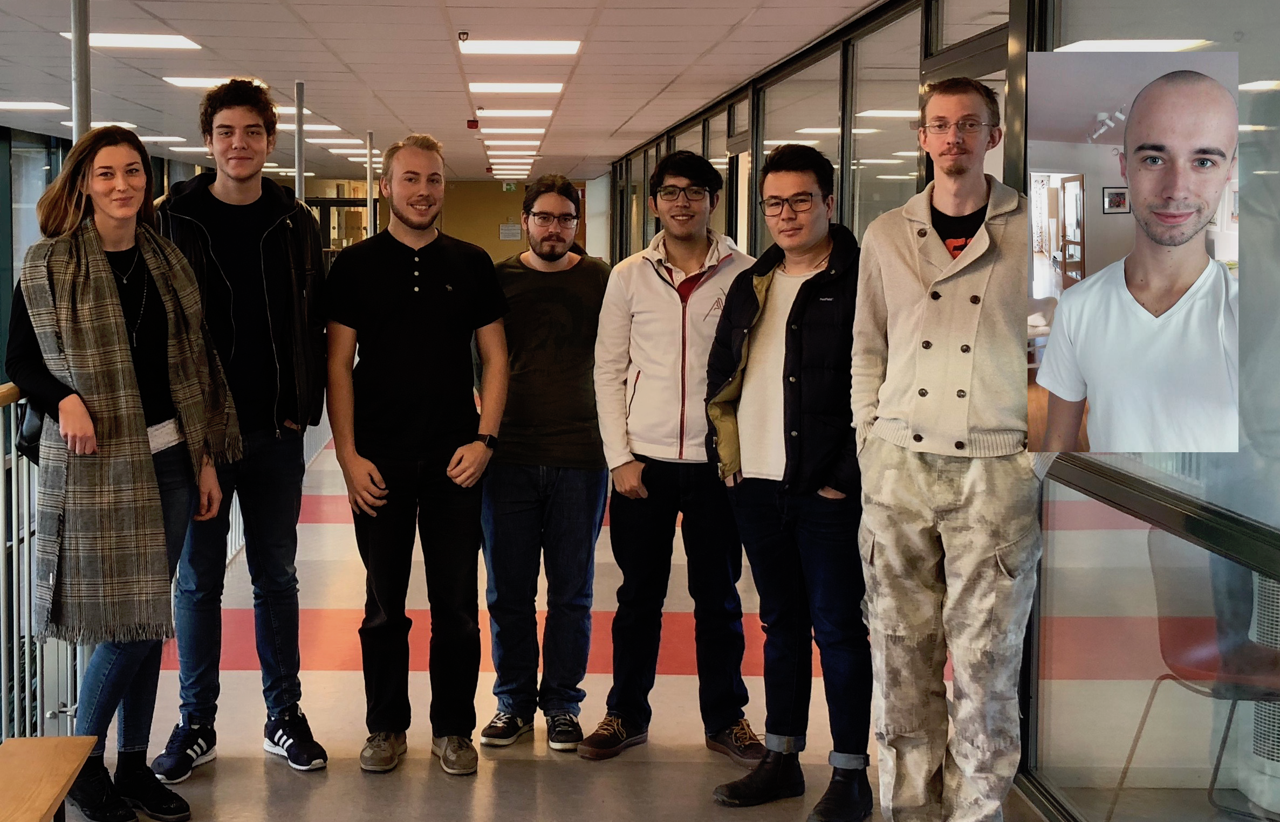
Group 1

Slide 2
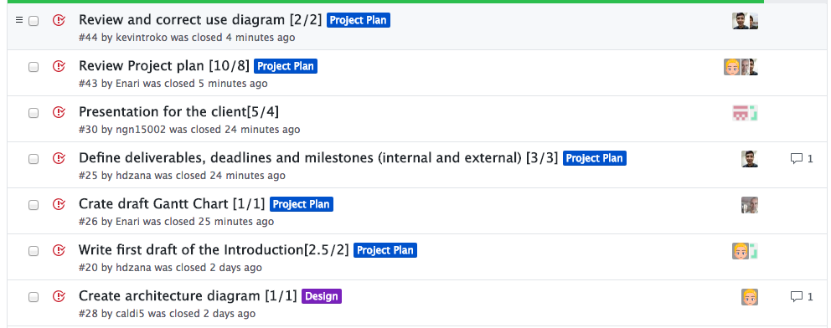
Previous Week
Finished project plan

Slide 3
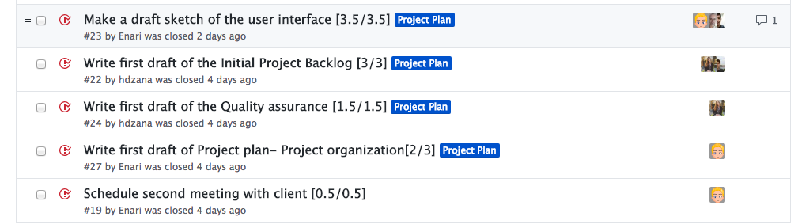
Previous Week

Slide 4
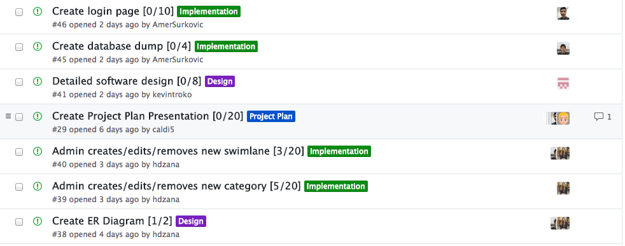
This Week

Slide 5
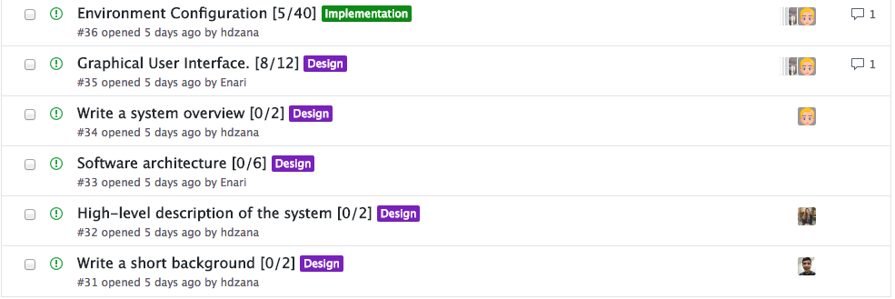
This Week

Slide 6
Obstacles & Issues
Team Forge

Slide 7
Hours Worked
André: 22 hours
Anton: 26 hours
Amer: 25 hours
Džana: 28 hours
Jawid: 25 hours
Kevin: 17 hours
Robert: 22 hours
Noah: 14 hours
Total: 179 hours

Slide 8
Questions
Can we update the project plan for highest grade?

